Slide 1


UNIT 1
UNIT 1
LIFE FORMS

Slide 2
BIO
LIFE
Greek Origin
biology, biography, biodiversity

Slide 3

BIOLOGY
BIOLOGY
(n)- the study of living things and how they grow and change
When we dissected a frog in biology, it helped us understand how its organs work together to maintain life.

Slide 4

BIOGRAPHY
BIOGRAPHY
(n)-a story written about someone's life
For her book report, Jenna chose to read a biography of Marie Curie to learn more about the famous scientist's life and discoveries.

Slide 5

BIODIVERSITY
BIODIVERSITY
(n)- the variety of different types of life found in an area
The Amazon rainforest is known for its incredible biodiversity, hosting thousands of different species of plants and animals.

Slide 6
VITA/VIV
LIFE
Latin Origin
vital, vitamin, vitality,vivacious

Slide 7

VITAL
VITAL
(adj)-very important or necessary for life or survival
Drinking water is vital for survival because it keeps our bodies hydrated and helps with various bodily functions.

Slide 8

VITAMIN
VITAMIN
(n)- a natural substance found in food that helps your body stay healthy
Carrots are high in vitamin A, which is essential for good vision and a strong immune system.

Slide 9
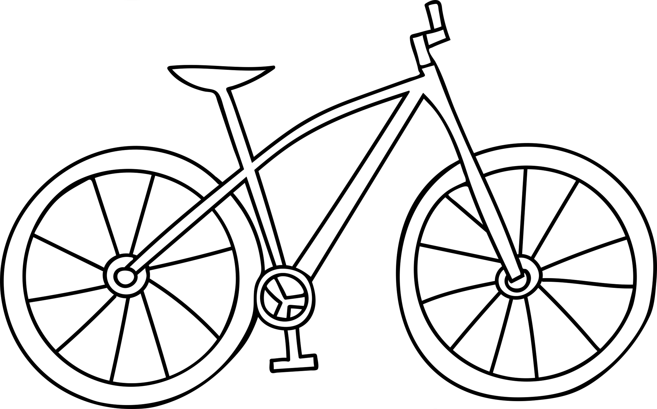
VITALITY
VITALITY
(n)- the power or energy to live a dynamic, active life
Grandpa says his daily morning walk is the secret to his energy and vitality.

Slide 10

VIVACIOUS
VIVACIOUS
(adj)-lively and spirited
Her vivacious personality lights up the room, always full of energy and life.

Slide 11
ZOO/ZO
ANIMAL
Greek Origin
zoology, zookeeper, protozoan

Slide 12

ZOOLOGY
ZOOLOGY
zoology: (n)the scientific study of animals and their behavior
Sarah's interest in zoology began when she volunteered at the animal shelter, sparking a passion for learning about animal behaviors and habitats.

Slide 13
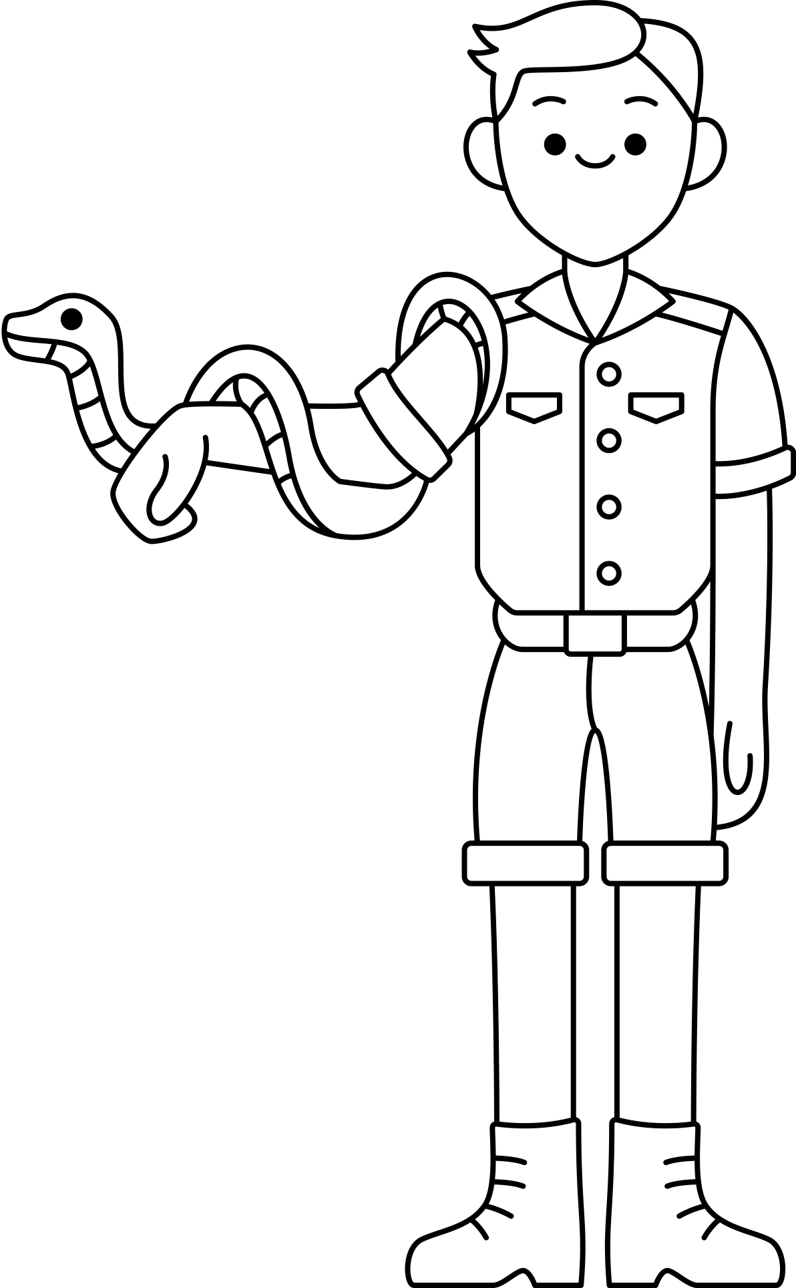
ZOOKEEPER
ZOOKEEPER
(n) a person who takes care of animals in a zoo
The zookeeper takes care of the animals by feeding them, keeping their habitats clean, and monitoring their health.

Slide 14
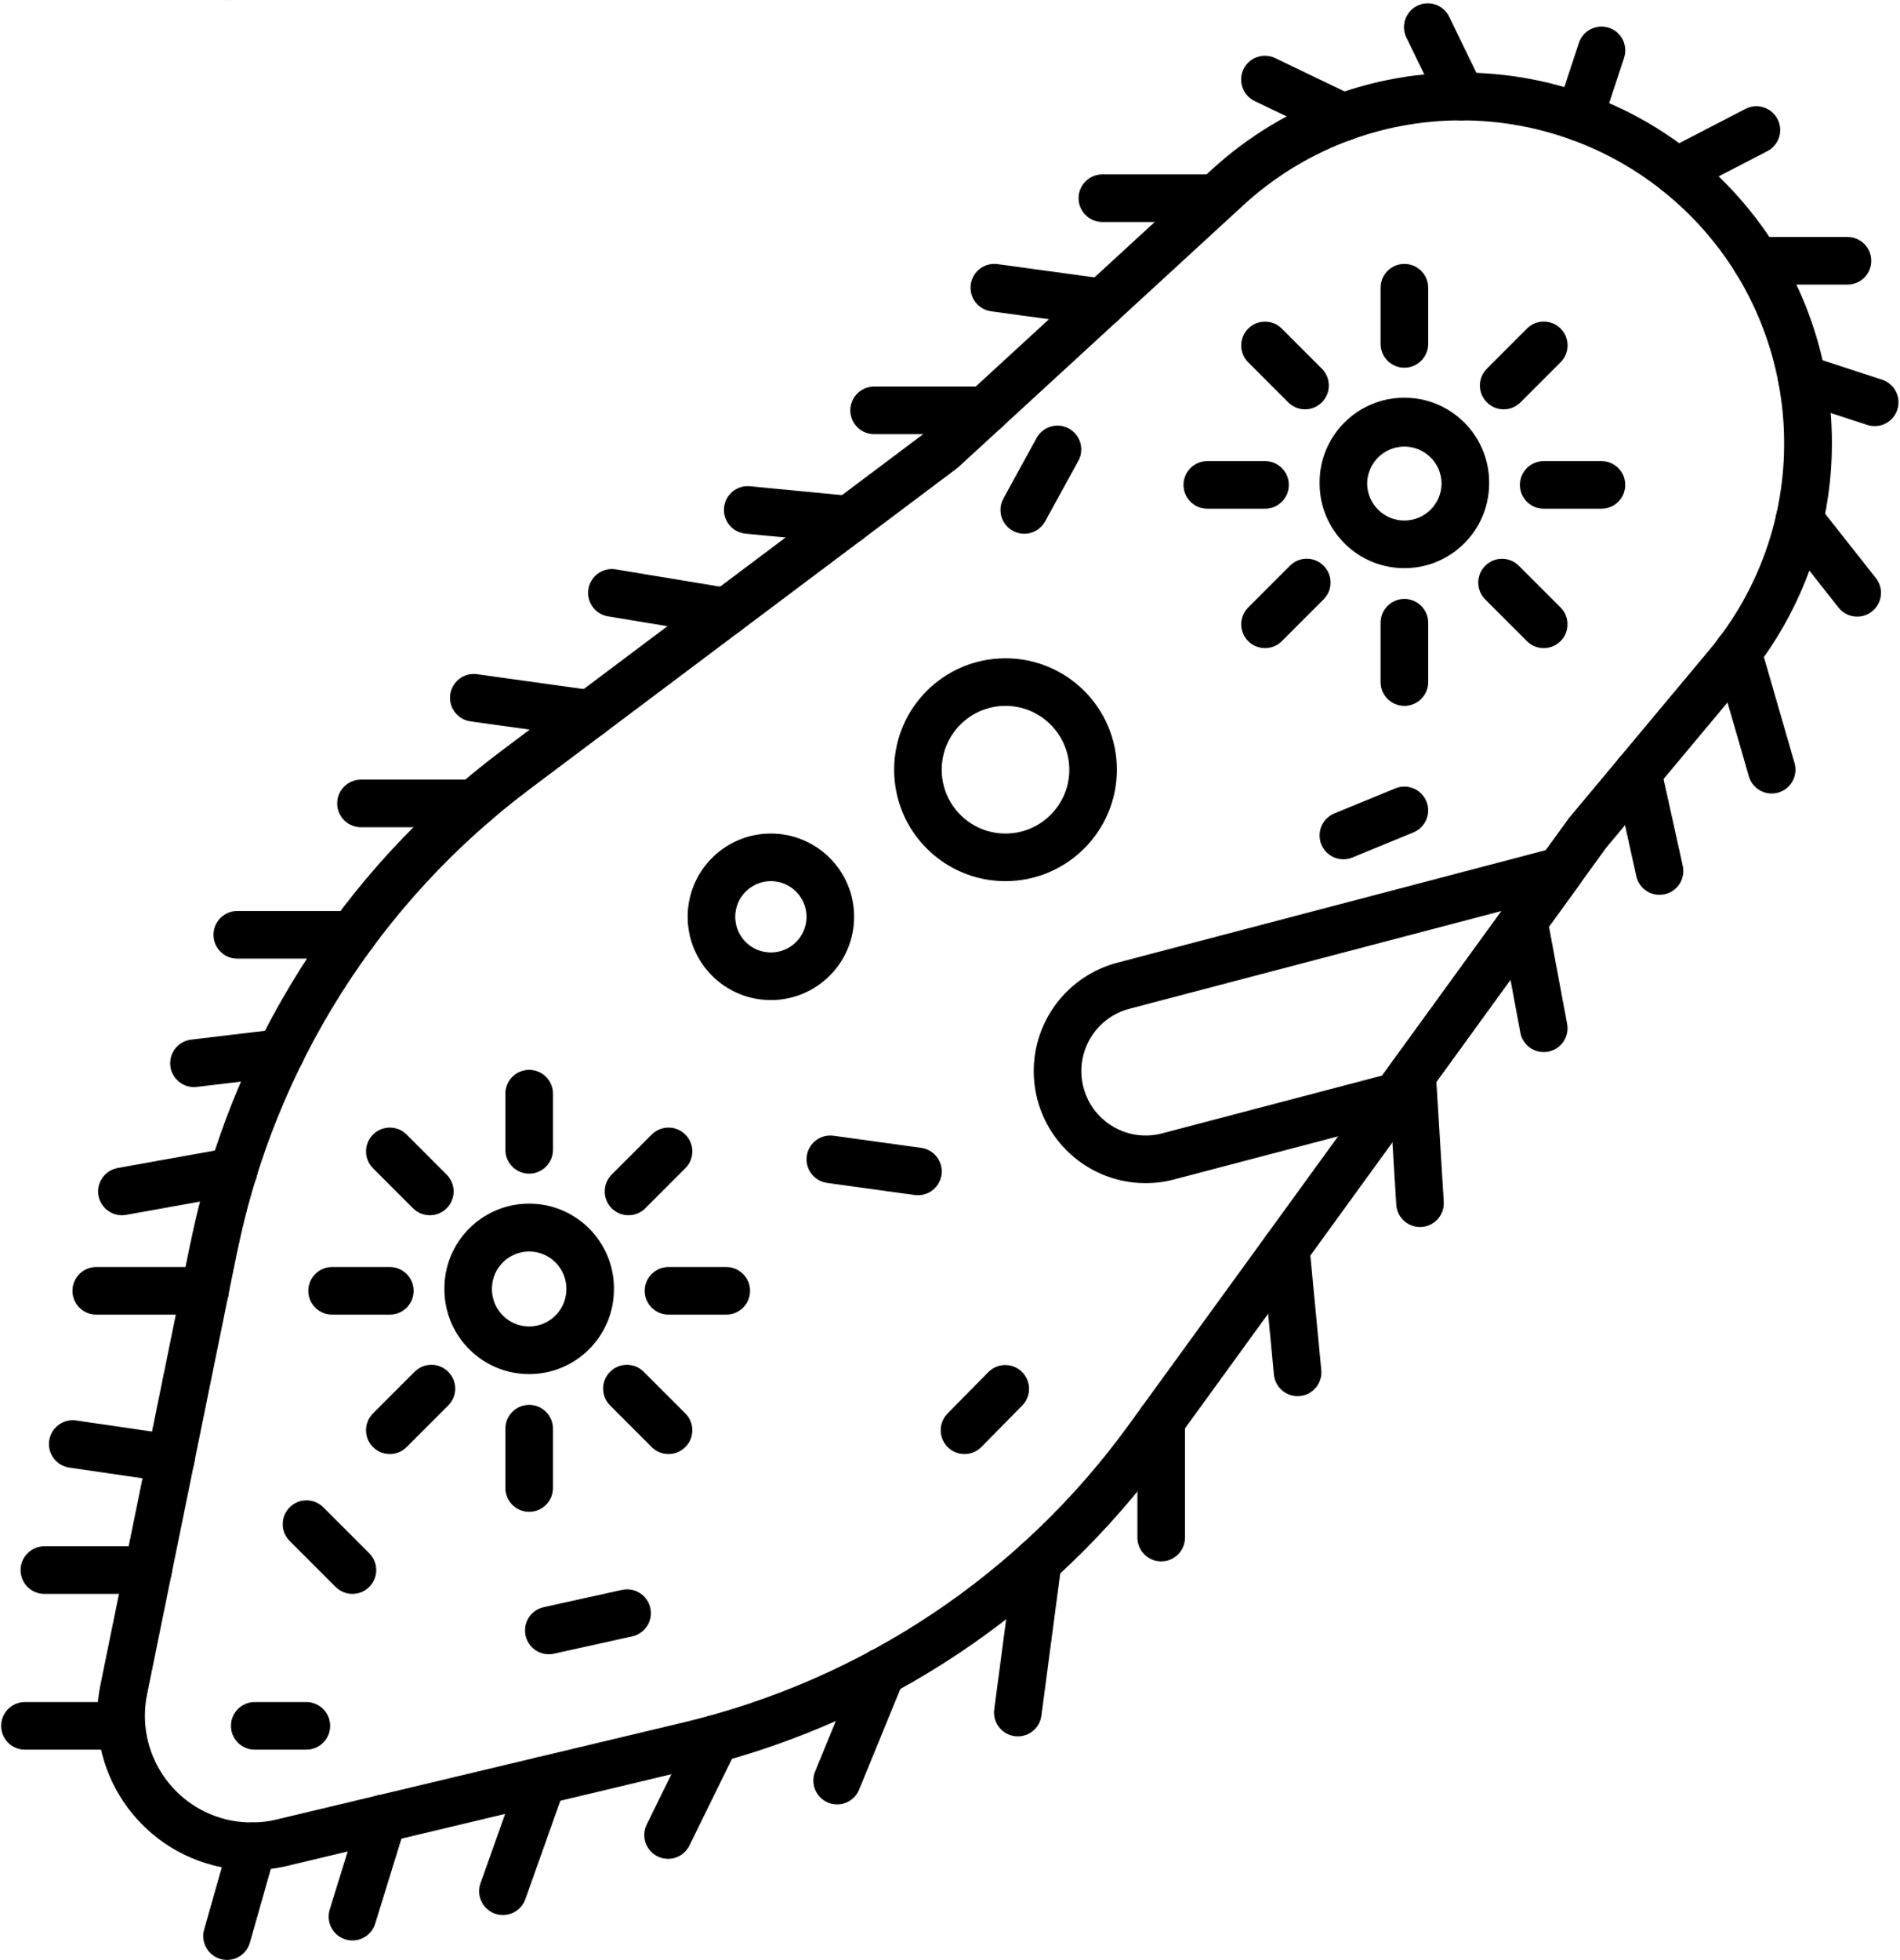
PROTOZOAN
PROTOZOAN
(n) a tiny, often one-celled animal that can be found in water, soil, or other organisms
In science class, we observed a protozoan under the microscope, marveling at how even such a tiny creature could have complex movements and behaviors.

