Slide 1
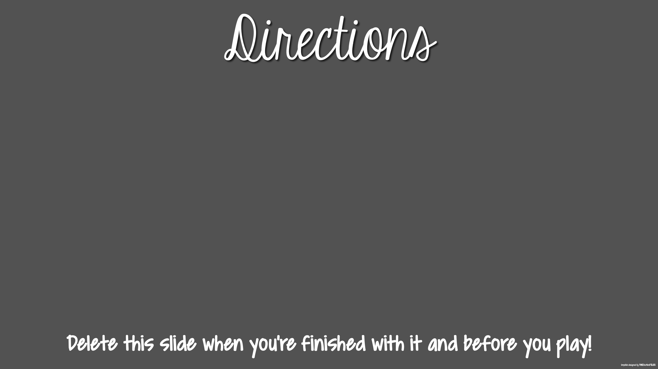
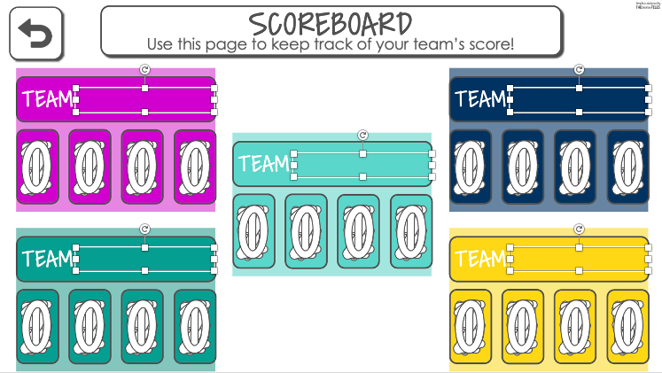
This Jeopardy Review Game is great for whole group, small group, in person, and distance learning. A few hints:
This resource includes text boxes. Please only modify the text boxes on the Scoreboard Slide.
Before playing, you will need to set up a few things with you class in order to use the Scoreboard feature. You will need to pick and type in Team Names on the slide.
Once you start to play (in Slideshow Mode) DO NOT exit the game until you are done. Otherwise, your completed question links on the Main Slide will reappear. Your Scoreboard will also reset to zero.
To Present: Click View → Slideshow
Directions to Zoom Share Your Computer Screen: CLICK HERE

Slide 2
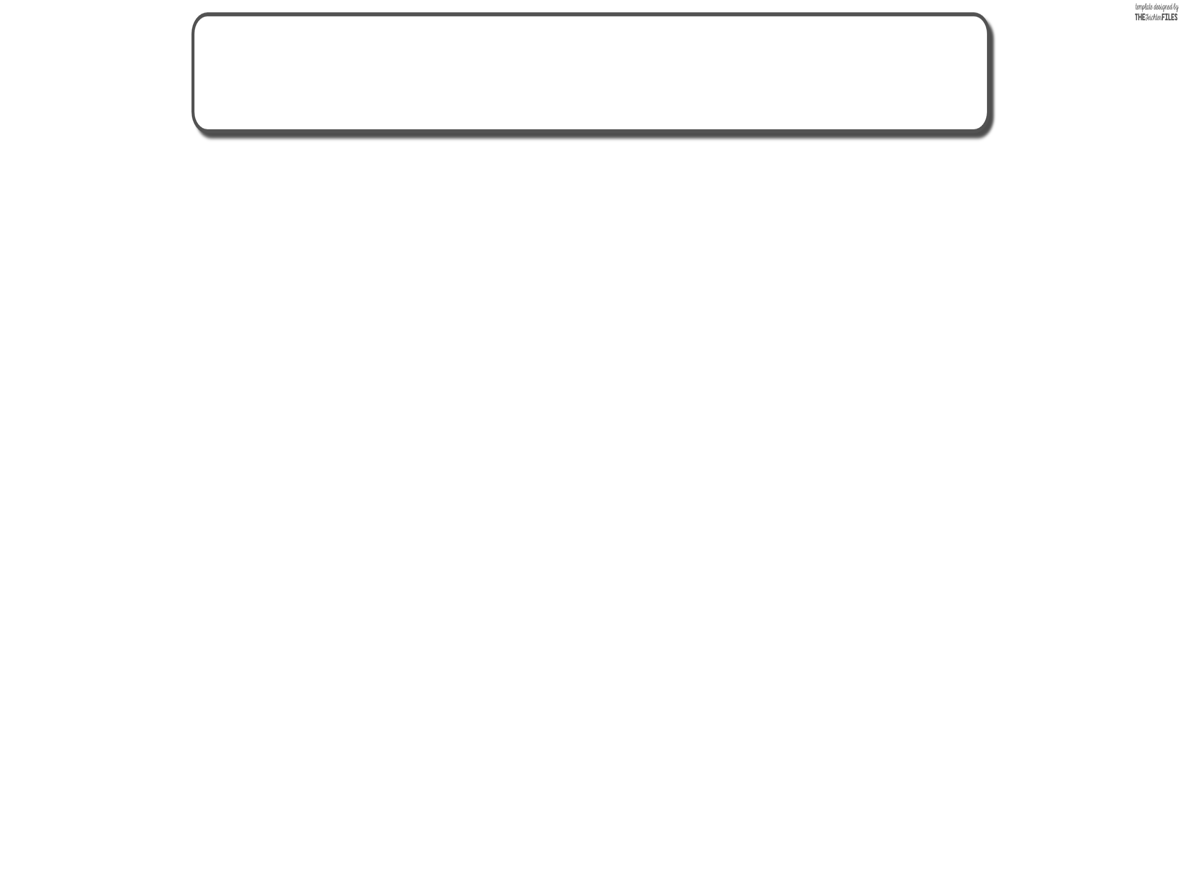

Parts of Speech
NOUNS & PRONOUNS
INTERJECTIONS & PREPOSITIONS
ADJECTIVES & ADVERBS
VERBS
CONJUNCTIONS
100
100
100
100
100
200
200
200
200
200
300
300
300
300
300
400
400
400
400
400
500
500
500
500
500
Notes:
This is the main Game Page. The point buttons are linked to the questions and will disappear after the question is answered while in Presentation Mode. The calculator button links to the Scorekeeping Page.

Slide 3
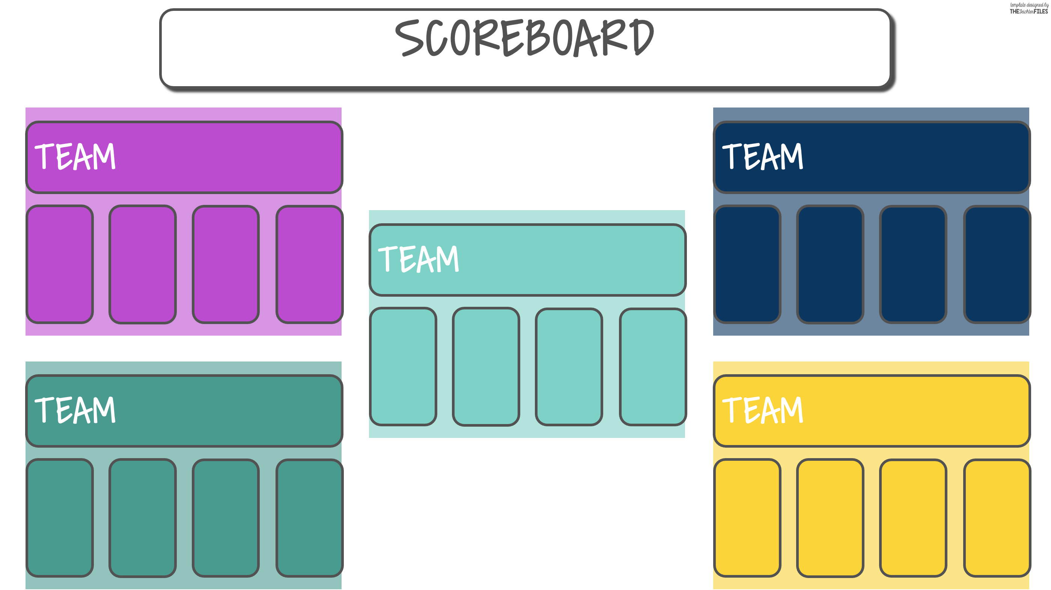








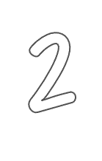
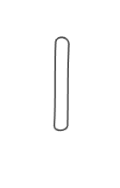

Use this page to keep track of your team’s score!
Notes:
Use this page to calculate and record team scores. There are text boxes included for Team Names. Be sure to name your teams before you start playing. Click on the digits to enter in your score. Refer back to this page throughout the game to keep track of the scores. The back button takes you back to the main game page. WARNING: if you exit “Presentation Mode” your scores will zero out.

Slide 4
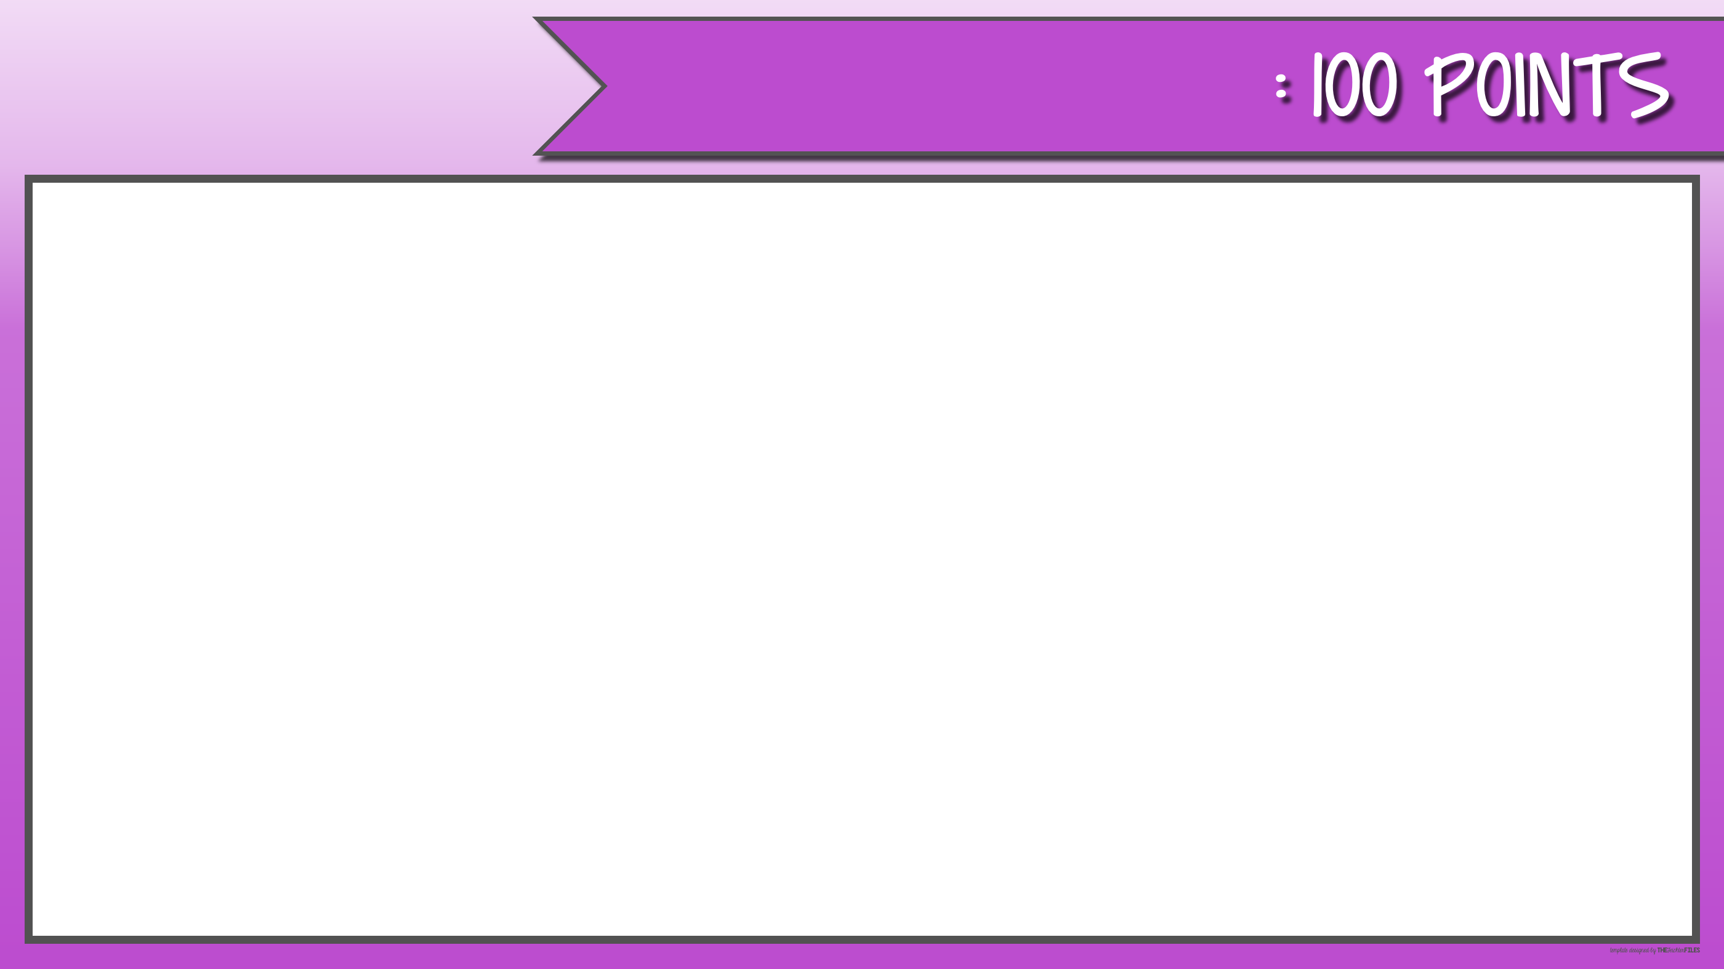
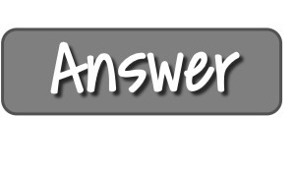
NOUNS & PRONOUNS
Identify the noun in the sentence:
I love Siesta Key Beach.
Notes:
The answer box is linked to the answer slide. The back button links back to the main page. The calculator button links to the calculate your score page.

Slide 5
NOUNS & PRONOUNS
Siesta Key Beach
Notes:
The answer box is linked to the answer slide. The back button links back to the main page. The calculator button links to the calculate your score page.

Slide 6
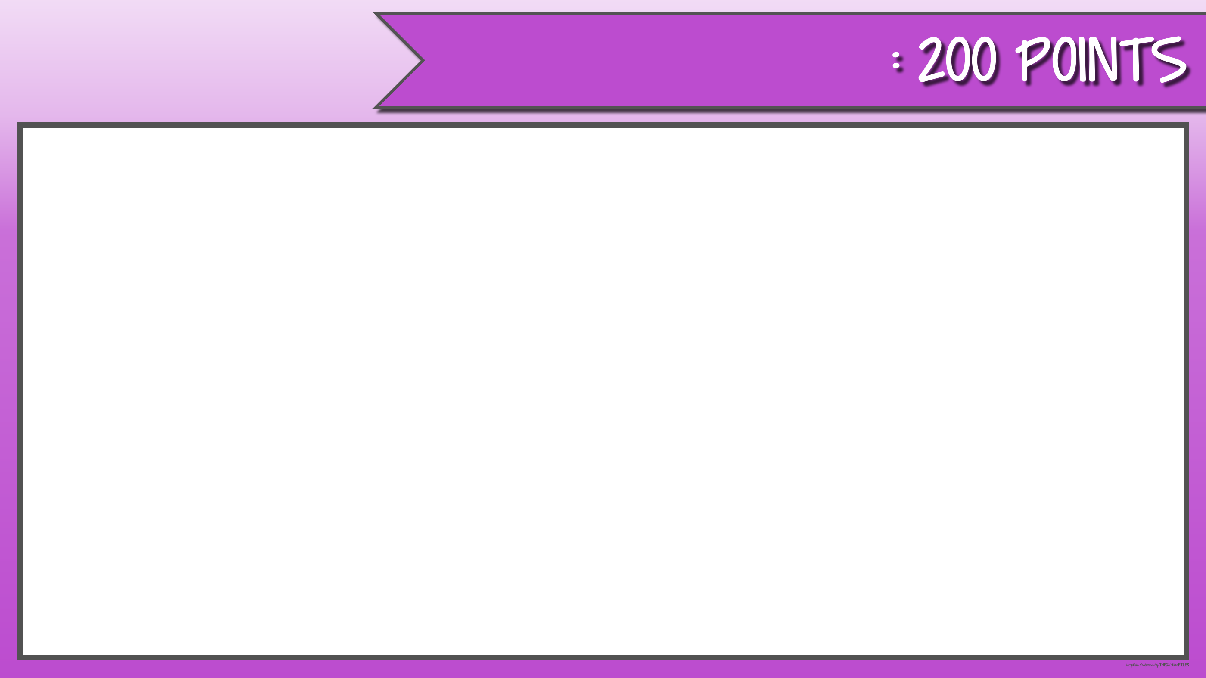
NOUNS & PRONOUNS
Identify the pronouns in the sentence:
She always spells his name wrong.
Notes:
The answer box is linked to the answer slide. The back button links back to the main page. The calculator button links to the calculate your score page.

Slide 7
NOUNS & PRONOUNS
She
his
Notes:
The answer box is linked to the answer slide. The back button links back to the main page. The calculator button links to the calculate your score page.

Slide 8

NOUNS & PRONOUNS
Identify the pronoun in the sentence:
Mr. Arnold is so kind. He is the best teacher.
Notes:
The answer box is linked to the answer slide. The back button links back to the main page. The calculator button links to the calculate your score page.

Slide 9
NOUNS & PRONOUNS
He
Notes:
The answer box is linked to the answer slide. The back button links back to the main page. The calculator button links to the calculate your score page.

Slide 10

NOUNS & PRONOUNS
Identify the pronoun and noun in the sentence:
They always make the best cookies.
Notes:
The answer box is linked to the answer slide. The back button links back to the main page. The calculator button links to the calculate your score page.

Slide 11
NOUNS & PRONOUNS
pronoun-They
noun-cookies
Notes:
The answer box is linked to the answer slide. The back button links back to the main page. The calculator button links to the calculate your score page.

Slide 12

NOUNS & PRONOUNS
Identify the pronouns and nouns in the sentence:
When you walk to the store, make sure you look for their bikes on the way.
Notes:
The answer box is linked to the answer slide. The back button links back to the main page. The calculator button links to the calculate your score page.

Slide 13
NOUNS & PRONOUNS
Pronouns: you
their
Nouns: store
bike
Notes:
The answer box is linked to the answer slide. The back button links back to the main page. The calculator button links to the calculate your score page.

Slide 14

CONJUNCTIONS
Identify the conjunction in the sentence:
Let’s visit Broadway and the Statue of Liberty.
Notes:
The answer box is linked to the answer slide. The back button links back to the main page. The calculator button links to the calculate your score page.

Slide 15
CONJUNCTIONS
and
Notes:
The answer box is linked to the answer slide. The back button links back to the main page. The calculator button links to the calculate your score page.

Slide 16

CONJUNCTIONS
Identify the conjunction in the sentence:
I’ve never been to Broadway nor the Statue of Liberty.
Notes:
The answer box is linked to the answer slide. The back button links back to the main page. The calculator button links to the calculate your score page.

Slide 17
CONJUNCTIONS
nor
Notes:
The answer box is linked to the answer slide. The back button links back to the main page. The calculator button links to the calculate your score page.

Slide 18

CONJUNCTIONS
Identify the conjunction in the sentence:
We wanted to visit grandma, but there was too much snow on the ground.
Notes:
The answer box is linked to the answer slide. The back button links back to the main page. The calculator button links to the calculate your score page.

Slide 19
CONJUNCTIONS
but
Notes:
The answer box is linked to the answer slide. The back button links back to the main page. The calculator button links to the calculate your score page.

Slide 20

CONJUNCTIONS
Identify the conjunction in the sentence:
Make sure you bring your binder for math class.
Notes:
The answer box is linked to the answer slide. The back button links back to the main page. The calculator button links to the calculate your score page.

Slide 21
CONJUNCTIONS
for
Notes:
The answer box is linked to the answer slide. The back button links back to the main page. The calculator button links to the calculate your score page.

Slide 22

CONJUNCTIONS
Identify the conjunction in the sentence:
I didn’t want to visit the haunted house, yet here we are.
Notes:
The answer box is linked to the answer slide. The back button links back to the main page. The calculator button links to the calculate your score page.

Slide 23
CONJUNCTIONS
yet
Notes:
The answer box is linked to the answer slide. The back button links back to the main page. The calculator button links to the calculate your score page.

Slide 24

INTERJECTIONS & PREPOSITIONS
Identify the interjection in the sentence:
Yes! I made the team.
Notes:
The answer box is linked to the answer slide. The back button links back to the main page. The calculator button links to the calculate your score page.

Slide 25
INTERJECTIONS & PREPOSITIONS
Yes!
Notes:
The answer box is linked to the answer slide. The back button links back to the main page. The calculator button links to the calculate your score page.

Slide 26

INTERJECTIONS & PREPOSITIONS
Identify the preposition in the sentence:
Go to bed!
Notes:
The answer box is linked to the answer slide. The back button links back to the main page. The calculator button links to the calculate your score page.

Slide 27
INTERJECTIONS & PREPOSITIONS
to
Notes:
The answer box is linked to the answer slide. The back button links back to the main page. The calculator button links to the calculate your score page.

Slide 28

INTERJECTIONS & PREPOSITIONS
Identify the interjection and preposition in the sentence:
AHH! The bees are flying out of the hive.
Notes:
The answer box is linked to the answer slide. The back button links back to the main page. The calculator button links to the calculate your score page.

Slide 29
INTERJECTIONS & PREPOSITIONS
Interjection: AHH!
Preposition: out of
Notes:
The answer box is linked to the answer slide. The back button links back to the main page. The calculator button links to the calculate your score page.

Slide 30

INTERJECTIONS & PREPOSITIONS
Identify the preposition in the sentence:
Climb aboard the Galaxy Tracker.
Notes:
The answer box is linked to the answer slide. The back button links back to the main page. The calculator button links to the calculate your score page.

Slide 31
INTERJECTIONS & PREPOSITIONS
aboard
Notes:
The answer box is linked to the answer slide. The back button links back to the main page. The calculator button links to the calculate your score page.

Slide 32

INTERJECTIONS & PREPOSITIONS
Identify the prepositions in the sentence:
Over the river and through the woods to grandmother’s house, we go.
Notes:
The answer box is linked to the answer slide. The back button links back to the main page. The calculator button links to the calculate your score page.

Slide 33
INTERJECTIONS & PREPOSITIONS
Over
through
to
Notes:
The answer box is linked to the answer slide. The back button links back to the main page. The calculator button links to the calculate your score page.

Slide 34
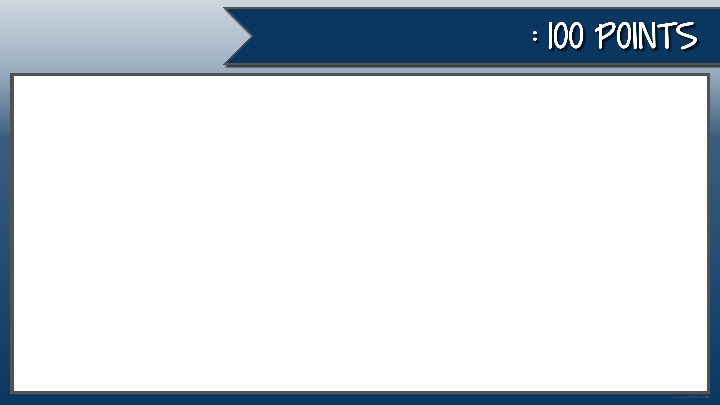
ADJECTIVES & ADVERBS
Identify the adverb in the sentence:
Close the door gently behind you.
Notes:
The answer box is linked to the answer slide. The back button links back to the main page. The calculator button links to the calculate your score page.

Slide 35
ADJECTIVES & ADVERBS
gently
Notes:
The answer box is linked to the answer slide. The back button links back to the main page. The calculator button links to the calculate your score page.

Slide 36

ADJECTIVES & ADVERBS
Identify the adverb in the sentence:
His snores are really explosive.
Notes:
The answer box is linked to the answer slide. The back button links back to the main page. The calculator button links to the calculate your score page.

Slide 37
ADJECTIVES & ADVERBS
really
Notes:
The answer box is linked to the answer slide. The back button links back to the main page. The calculator button links to the calculate your score page.

Slide 38

ADJECTIVES & ADVERBS
Identify the adverb in the sentence:
I eat entirely too much on Thanksgiving.
Notes:
The answer box is linked to the answer slide. The back button links back to the main page. The calculator button links to the calculate your score page.

Slide 39
ADJECTIVES & ADVERBS
entirely
Notes:
The answer box is linked to the answer slide. The back button links back to the main page. The calculator button links to the calculate your score page.

Slide 40

ADJECTIVES & ADVERBS
Identify the adjectives in the sentence:
Ancient mammoths were huge, wooly creatures.
Notes:
The answer box is linked to the answer slide. The back button links back to the main page. The calculator button links to the calculate your score page.

Slide 41
ADJECTIVES & ADVERBS
Ancient
huge
wooly
Notes:
The answer box is linked to the answer slide. The back button links back to the main page. The calculator button links to the calculate your score page.

Slide 42

ADJECTIVES & ADVERBS
Identify the adjective in the sentence:
A New York museum is home to a dinosaur skeleton.
Notes:
The answer box is linked to the answer slide. The back button links back to the main page. The calculator button links to the calculate your score page.

Slide 43
ADJECTIVES & ADVERBS
New York
Notes:
The answer box is linked to the answer slide. The back button links back to the main page. The calculator button links to the calculate your score page.

Slide 44

VERBS
Identify the verb in the sentence:
I jumped so high on the trampoline.
Notes:
The answer box is linked to the answer slide. The back button links back to the main page. The calculator button links to the calculate your score page.

Slide 45
VERBS
jumped
Notes:
The answer box is linked to the answer slide. The back button links back to the main page. The calculator button links to the calculate your score page.

Slide 46
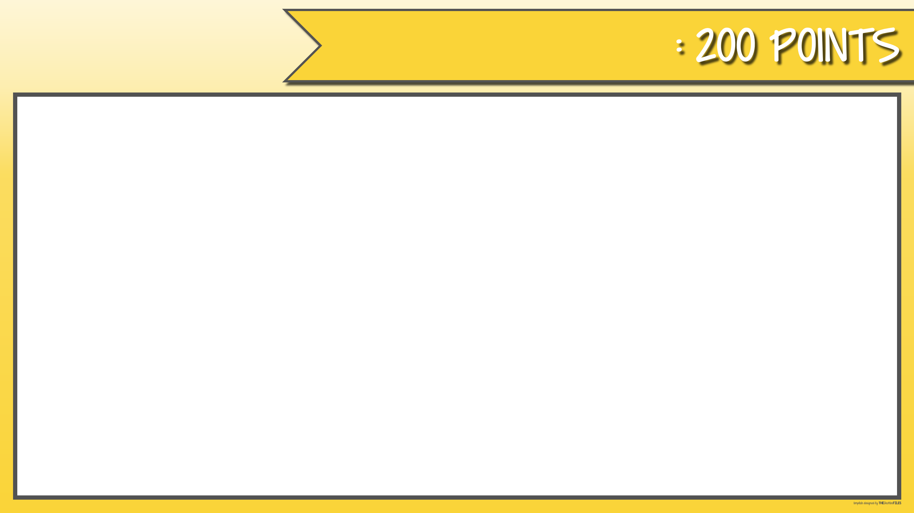
VERBS
Identify the verb in the sentence:
Natural disasters hit the globe nearly every day.
Notes:
The answer box is linked to the answer slide. The back button links back to the main page. The calculator button links to the calculate your score page.

Slide 47
VERBS
hit
Notes:
The answer box is linked to the answer slide. The back button links back to the main page. The calculator button links to the calculate your score page.

Slide 48

VERBS
Identify the verb in the sentence:
She wonders if there is life on another planet.
Notes:
The answer box is linked to the answer slide. The back button links back to the main page. The calculator button links to the calculate your score page.

Slide 49
VERBS
wonders
Notes:
The answer box is linked to the answer slide. The back button links back to the main page. The calculator button links to the calculate your score page.

Slide 50

VERBS
Identify the verb in the sentence:
I dream of an adventure to the moon.
Notes:
The answer box is linked to the answer slide. The back button links back to the main page. The calculator button links to the calculate your score page.

Slide 51
VERBS
dream
Notes:
The answer box is linked to the answer slide. The back button links back to the main page. The calculator button links to the calculate your score page.

Slide 52

VERBS
Identify the verbs in the sentence:
I feel uneasy whenever I hear about earthquakes.
Notes:
The answer box is linked to the answer slide. The back button links back to the main page. The calculator button links to the calculate your score page.

Slide 53
VERBS
feel
hear
Notes:
The answer box is linked to the answer slide. The back button links back to the main page. The calculator button links to the calculate your score page.

