Slide 1
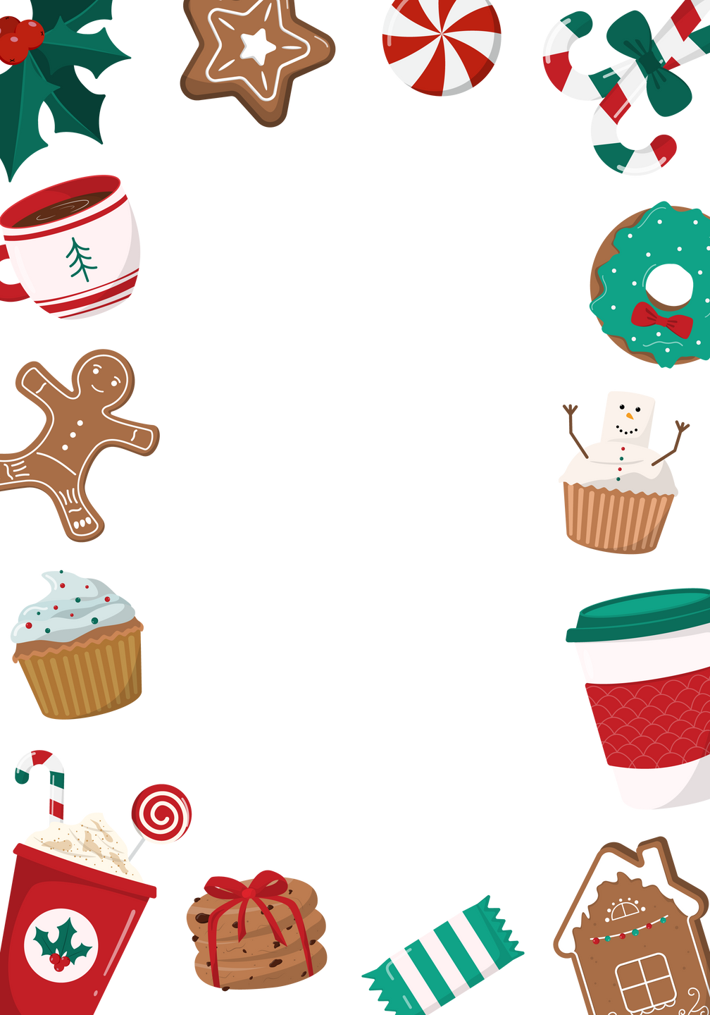
You wake up to find you're an elf in Santa's workshop. Describe your day.

Slide 2
Write a story where Santa gets stuck in a chimney and the adventures that ensue.

Slide 3
Imagine a world where Christmas was during summer. How would the traditions and celebrations change?

Slide 4
A snowman comes to life in your backyard. What happens next?

Slide 5
You find a magical ornament that transports you to the North Pole when touched. Describe your journey.

Slide 6
Create a tale about a reindeer who was left behind and its adventure to catch up with Santa’s sleigh.

Slide 7
Write a story about a character who hates Christmas but is tasked with organizing the biggest Christmas event in town.

Slide 8
A family accidentally swaps Christmas traditions with their neighbors. What unusual traditions do they experience?

Slide 9
Invent a story about a Christmas tree that grants wishes.

Slide 10
Your pet suddenly gains the ability to speak on Christmas Eve. What do they say?

Slide 11
A group of kids get locked in a department store on Christmas Eve. Describe their night.

Slide 12
Write about a character who can hear Christmas ornaments talking. What stories do the ornaments tell?

Slide 13
A blizzard traps your family at home on Christmas. How do you celebrate?

Slide 14
You receive a Christmas card from an unknown sender that predicts the future. What does it say?

Slide 15
Create a story where Christmas lights have magical properties.

Slide 16
Santa loses his memory a week before Christmas. How do the elves restore it?

Slide 17
Write about the adventures of two children who find a secret passage to a winter wonderland.

Slide 18
A gingerbread man escapes from the oven. Tell his story.

Slide 19
A character finds a lost gift box with a mysterious note attached. What’s inside, and who is it for?

Slide 20
Discover a mysterious gift under the tree that wasn't there the night before. What is it, and where did it come from?

